Slide 1
Entity Framework Core
EF Core Fluent API configurations

Slide 2
Lesson Objectives
Fluent API Configurations
Entity Mappings
Property Mappings
Configure Relationships
EF Core Migration

Slide 3
Fluent API Configurations
Section 1

Slide 4
Fluent API Configurations
Entity Framework Fluent API is used to configure domain classes to override conventions.
In other words, we can use both Data Annotation attributes and Fluent API at the same time
Fluent API override Data Annotations attributes.

Slide 5
Fluent API Configurations
EF Fluent API is based on a Fluent API design pattern (a.k.a Fluent Interface) where the result is formulated by method chaining.
The DbModelBuilder class acts as a Fluent API.
It provides more options of configurations than Data Annotation attributes.

Slide 6
Fluent API Configurations
To write Fluent API configurations, override the OnModelCreating() method of DbContext in a context class
protected override void OnModelCreating(ModelBuilder modelBuilder)

Slide 7
Fluent API Configurations
Model-wide Configuration: Configures the default Schema, entities to be excluded in mapping, etc.
Entity Configuration: Configures entity to table and relationship mappings
e.g. PrimaryKey, Index, table name, one-to-one, one-to-many, many-to-many etc.
Property Configuration: Configures property to column mappings
e.g. column name, nullability, Foreignkey, data type, concurrency column, etc.

Slide 8
Entity Mappings
Configure Default Schema
Specifies the default database schema.
modelBuilder.HasDefaultSchema("Admin");
Map Entity to Table
Specifies the table name instead of default convention.
modelBuilder.Entity<Product>().ToTable(“NewProduct");
modelBuilder.Entity<Product>().ToTable("NewProduct", "Admin");

Slide 9
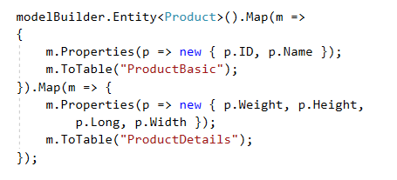
Map Entity to Multiple Tables
Map set of properties to each table
Used when:
Has many properties/columns
Separate table for difference used purposes

Slide 10
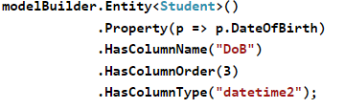
Property Mappings
HasKey
To configure a key property.
Override default convention, ID or <Entity>Id becomes normal column in SQL
modelBuilder.Entity<Product>().HasKey(p => p.ProductKey);
HasColumnName/Order/Type
To configure column name, order, data type in SQL

Slide 11
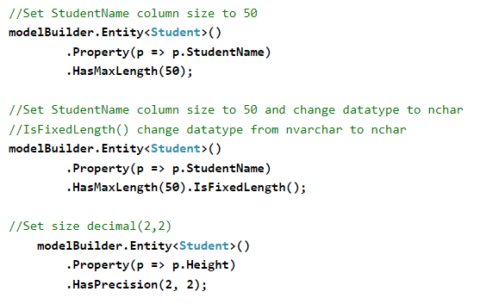
Property Mappings
IsOptional/IsRequired
To configure Null or NotNull Column
HasMaxLength
To configure maxlength
IsFixedLength
To change datatype from nvarchar to nchar
HasPrecision
To set size decimal

Slide 12
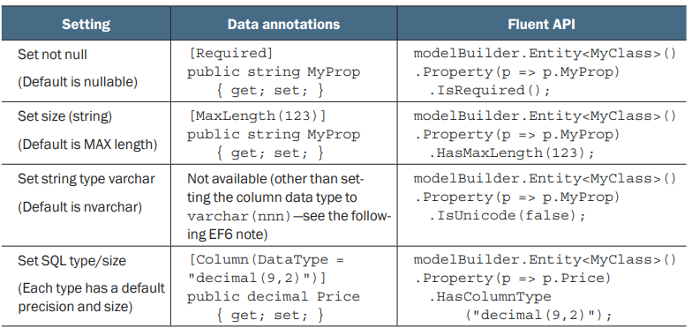
Property Mappings

Slide 13
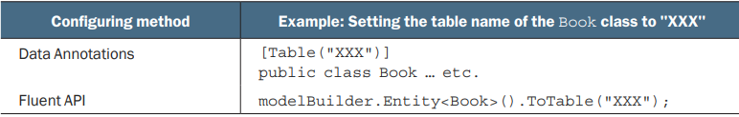
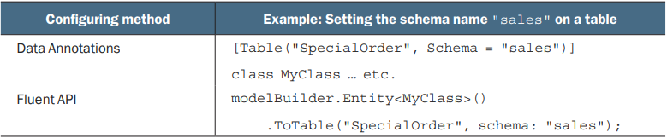
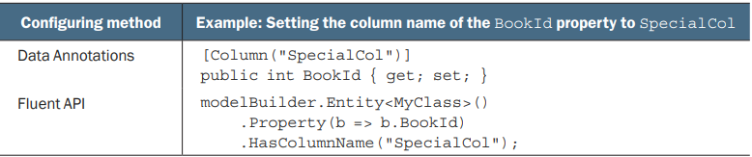
Property Mappings

Slide 14
Configure Relationships
Section 2

Slide 15
Configure One-to-Many Relationships
Step 1/4: start configuring with any one entity class.
Step 2/4: use .HasRequired() to specifies required property. This will create a NotNull foreign key column in the DB.

Slide 16
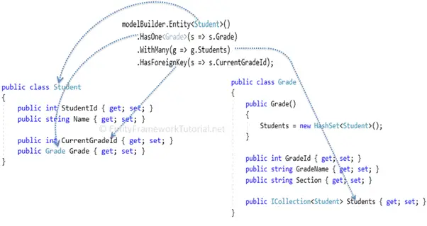
Configure One-to-Many Relationships
Step 3/4: use .WithMany() to specifies that the parent entity class includes many children entities. Here, many infers the ICollection type property.
Step 4/4: use .HasForeignKey() to specify the name of the foreign key

Slide 17
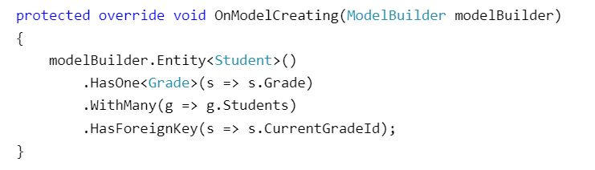
Configure One-to-Many Relationships
Configure the one-to-many relationship for the entities using Fluent API by overriding the OnModelCreating method in the context class,

Slide 18
Cascade delete (1)
What would happen if we try to delete a principal entity row?
Would that do nothing on dependent elements or remove them as well?
Cascade delete is a feature in EF Core that allows you to delete related entities when you delete the principal entity.
In other words, it enables you to delete all the dependent entities automatically when you delete the parent entity.
useful when you have a relationship between two entities, and you want to ensure that deleting the parent entity does not leave any orphaned child entities behind.

Slide 19
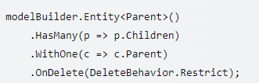
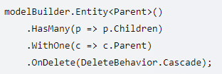
Cascade delete (2)
To enable cascade delete in EF Core, you can use the OnDelete method to specify the desired behavior
The following code would configure that the dependent rows would be deleted as well if the primary row is deleted:
Enable cascade delete for a one-to-many relationship
Disable cascade delete for a relationship
a Parent entity is deleted, any associated Child entities will not be deleted and will instead become orphaned

Slide 20
Configure One-to-One Relationship
Configure a One-to-Zero-or-One relationship
Get Entity from any side
Use HasOptional() to another entity
Use WithRequired() this entity

Slide 21
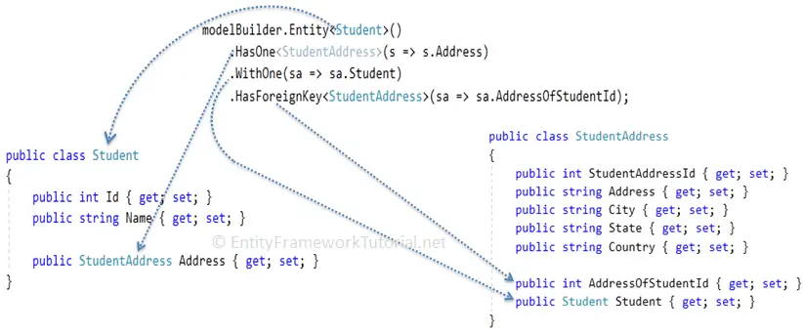
Configure One-to-One Relationship

Slide 22
Configure a Many-to-Many Relationship
The steps for configuring many-to-many relationships would the following:
Define a new joining entity class which includes the foreign key property and the reference navigation property for each entity.
Define a one-to-many relationship between other two entities and the joining entity, by including a collection navigation property in entities at both sides
Configure both the foreign keys in the joining entity as a composite key using Fluent API

Slide 23
Configure a Many-to-Many Relationship
Get Entity from any side
Use HasMany() to another entity
Use WithMany() to this entity
[Optional] Use Map
Use MapLeftKey
Use MapRightKey
Use ToTable

Slide 24
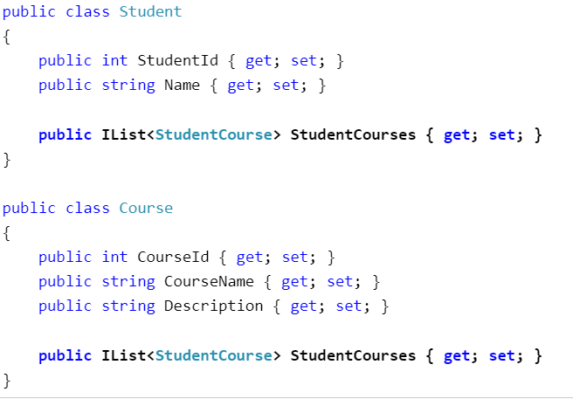

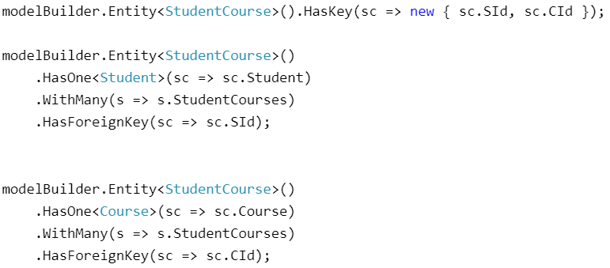
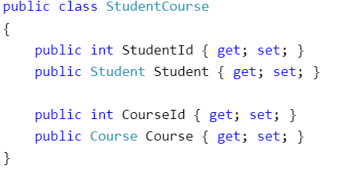
Configure a Many-to-Many Relationship

Slide 25
Fe CORE Migration
Section 3

Slide 26

Migrations in EF Core
Migration is a way to keep the database schema in sync with the EF Core model by preserving data.
EF Core API builds the EF Core model from the Domain classes
Data Annotations attributes applied on Domain classes
and Fluent API configurations in the DbContext class.
EF Core migrations API will create or update the database schema based on the EF Core model.
Whenever you change the domain classes, you need to run migration commands to keep the database schema up to date.

Slide 27
Migration Command
EF Core migrations are a set of commands:
Package Manager Console
PowerShell or .NET Core CLI (Command Line Interface).

Slide 28
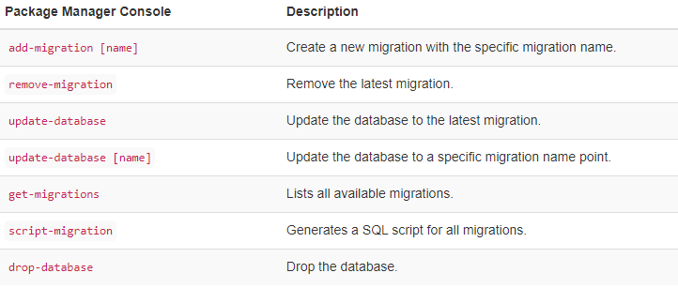
Package Manager Console

Slide 29
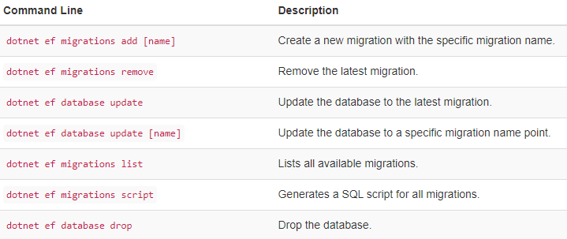
Command Line

Slide 30
Why you need migrations?
EF Core Migrations provides a flexible and convenient way to manage database changes, especially in team development environments where multiple developers might be making changes to the same database schema.
EF Core migrations are needed for several reasons:
Schema evolution: As your application evolves, so does the database schema. EF Core migrations enable you to track and manage these changes to the schema over time.
Easy database management: With EF Core migrations, you can manage database changes in a versioned manner, making it easier to manage the database as your application evolves.
Automated database creation: You can use EF Core migrations to create the database schema automatically, eliminating the need for manual SQL scripts or other manual database management processes.
Consistent database state: EF Core migrations ensure that all instances of the database are in a consistent state, reducing the likelihood of errors and inconsistencies in the database.
Improved collaboration: EF Core migrations make it easier for teams to work together on a project, as each developer can work with a local copy of the database that is in sync with the latest schema changes.

Slide 31
Using EF Core Migrations in steps
To use EF Core Migrations, you need to follow these steps:
Define your data model using EF Core's Code First approach. This involves creating classes that represent your database tables and relationships.
Install the necessary NuGet packages.
Create a DbContext class that inherits from DbContext. This class represents your database context and provides access to your data model.

Slide 32
Using EF Core Migrations in steps
Configure your DbContext to use a specific database provider.
Enable EF Core Migrations by running:
the add-migration command in the Package Manager Console
or by using the dotnet ef migrations add command in the terminal.
Apply the migrations to the database by running:
the update-database command in the Package Manager Console
or by using the dotnet ef database update command in the terminal.

Slide 33
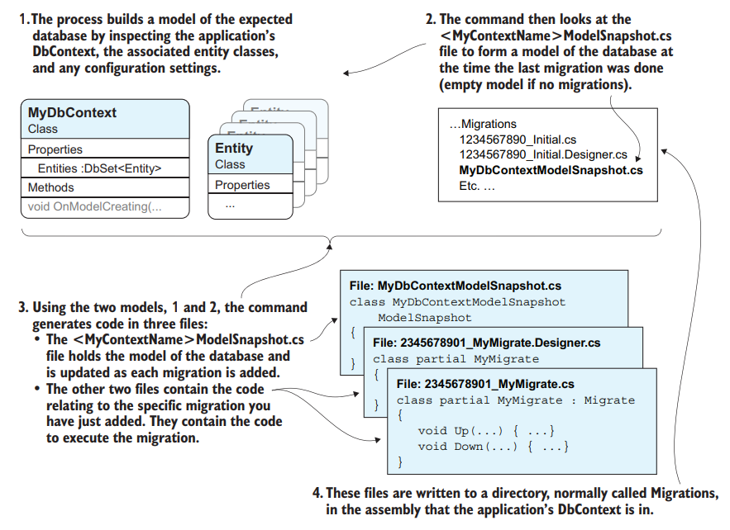

Migration Command - Add
Adding a Migration

Slide 34
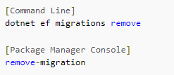
Migration Command - Removing
Removing commad:
use this command to remove the latest migration
the Remove-Migration command perform several tasks:
First, EF Core Tools fetch all migrations that have been applied to your database.
Then, EF Core Tools check if the latest migration has been applied.
An error will be thrown if that's the case.
The EF Core Tools then remove the latest unapplied migration by:
Removing the corresponding migration files from your project.
Updating the Model Snapshot to reflect the state before the latest migration.

Slide 35
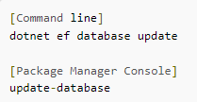
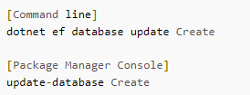
Migration Command – Update, Revert
Update Database
The command results in the Up method of the migration class being executed with any changes applied to the database
If this is the first migration, a table will be added to the database called _EFMigrationsHistory
It is used to store the name of this and each subsequent migration as they are applied to the database
Revert a migration
This action will result in the Down method in all subsequent migrations being executed
To reverse a migration, you pass the name of a target migration to the update command.
The target migration is the point at which you want to restore the database.
Any migrations that have been applied to the database after the target migration will have their entries removed from the __EFMigrationsHistory table in the database

Slide 36
Summary
Fluent
API
Conventions
Data Annotations Attributes
High Priority
Powerful
Most used

Slide 37
Summary
Add-Migration
Update-Database

Slide 38

Thank you

